Slide 1



Digital Marketing Campaign Conversion Prediction
Vilakshan Dhasmana

Slide 2
Problem Statement :
Organizations face the challenge of identifying potential customer converters in digital marketing, where inefficient resource allocation often leads to wasted advertising spend. By leveraging machine learning, the goal is to enhance targeting strategies and optimize marketing efforts to improve conversion rates.
The Objective of this project are as follows:
1. Develop a robust predictive model
2. Analyzing which campaign types and channels provide best ROI

Slide 3
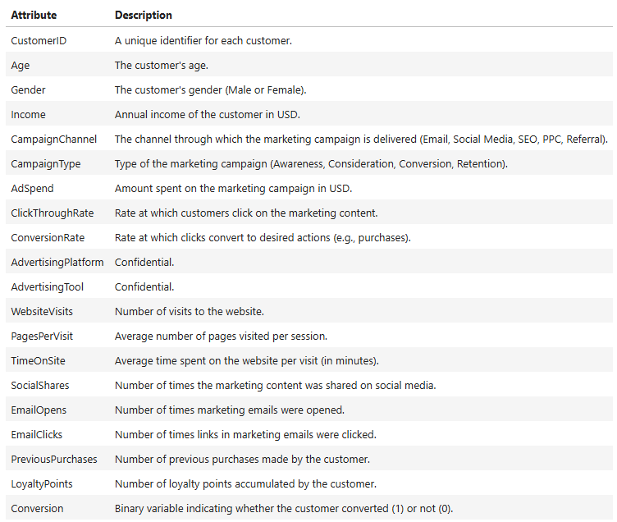
Dataset Description :
The datasets contains various features and a target variable called Conversions: 1 (converted), 0(Not Converted)
Shape: 8,000 rows & 20 columns
The data contains the following attributes:
What to Do?
Utilize various Classification Algorithms
Leverage Supervised Machine learning

Slide 4
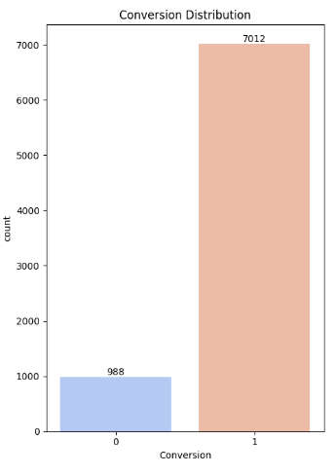
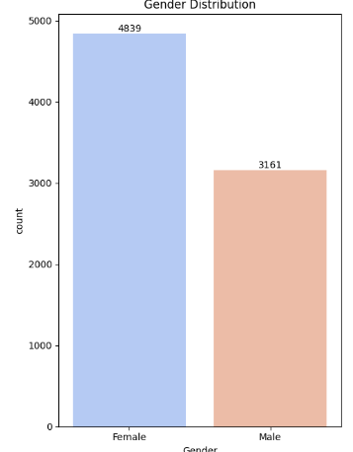
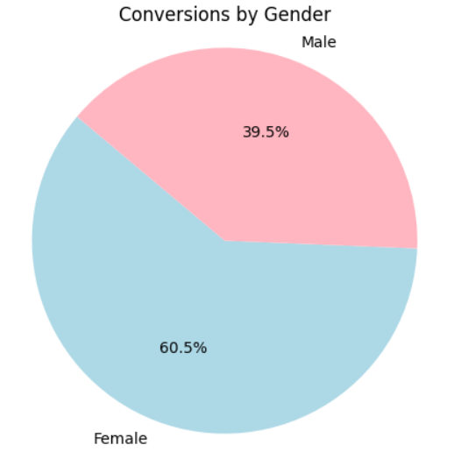
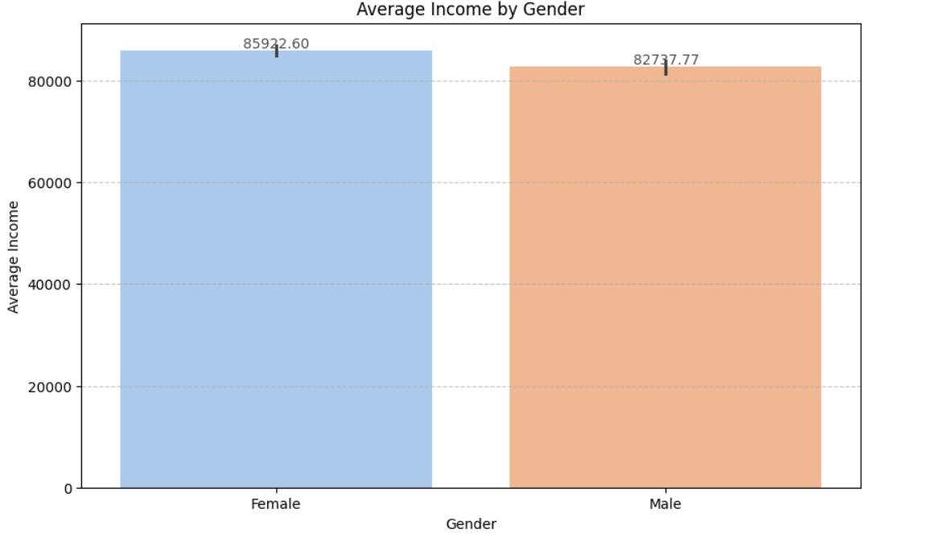
EDA (Exploratory Data Analysis) :
Data cleaning: Dropping of Customer Id, AdvertisingPlatform and AdvertisingTool
Data Visualization:
There is a clear imbalance in the data set as 87.65% are converted and only 12.35% are not converted
The data Contains more of Female users and they have more conversions as well even though there is isn’t a significant difference between the average Income of the 2 genders.

Slide 5
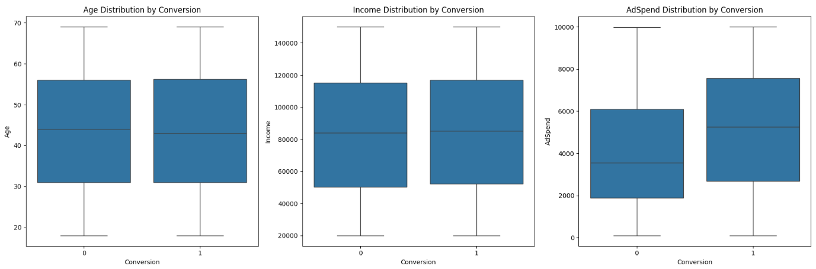
EDA (Exploratory Data Analysis) :
Data Visualization:
There is a clear correlation between ad spend and conversions as more Ad Spend is causing more conversions.
But there isn't any significant difference when it comes to age and income for conversions

Slide 6
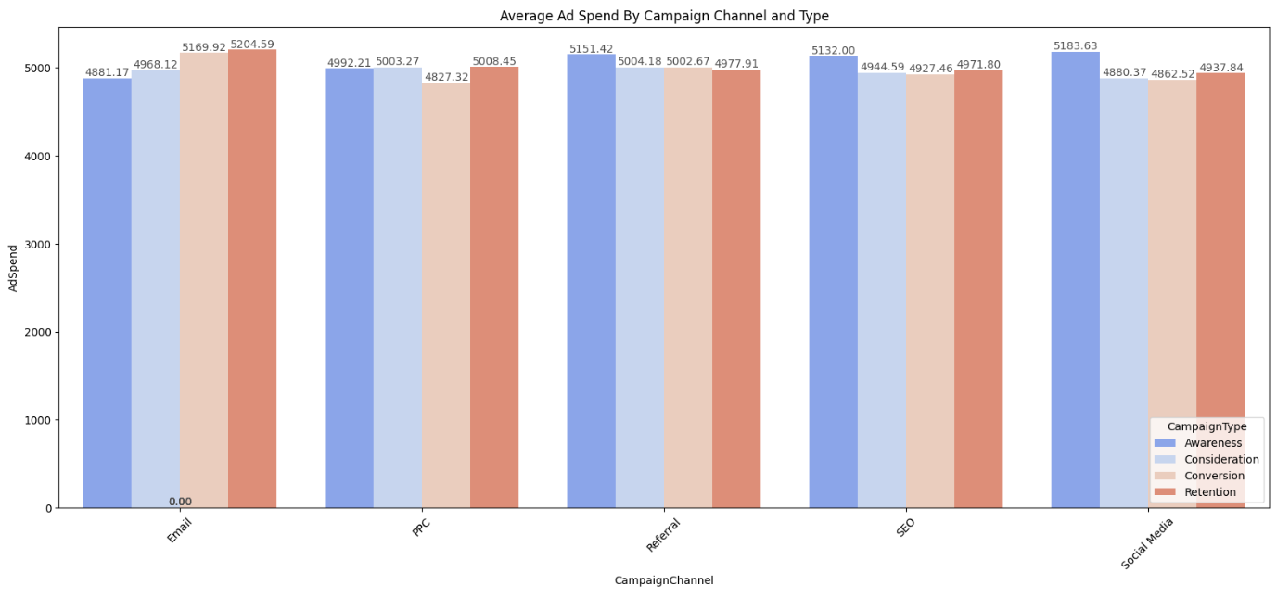
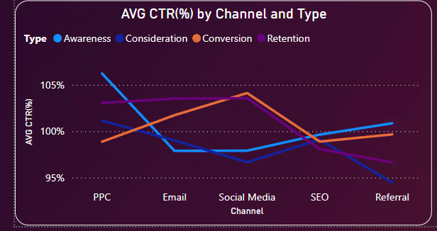
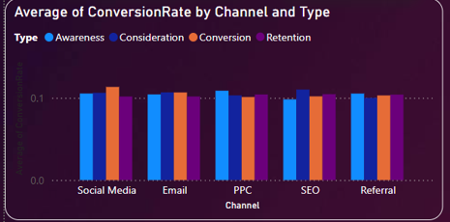
EDA (Exploratory Data Analysis) :
Data Visualization:
We can see the highest spend on Email in retention and Social media in awareness, and these 2 channels also have the highest ctr and conversion rate

Slide 7
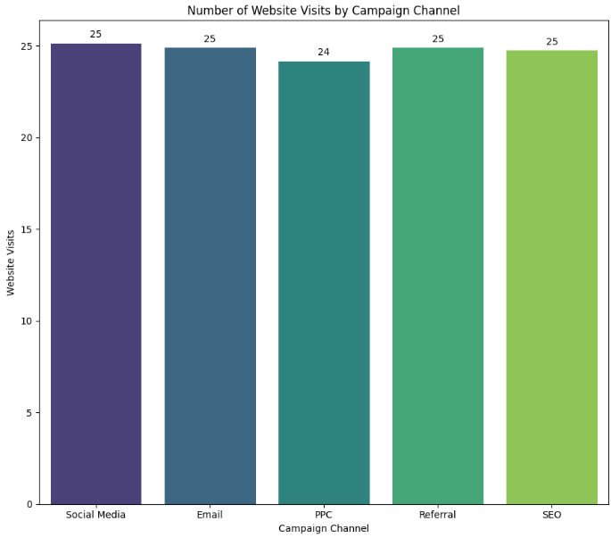
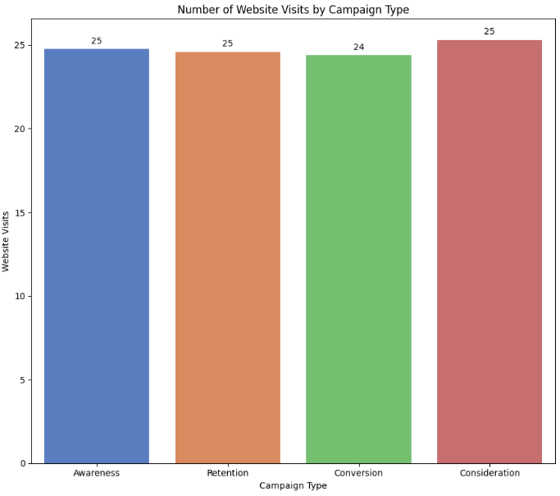
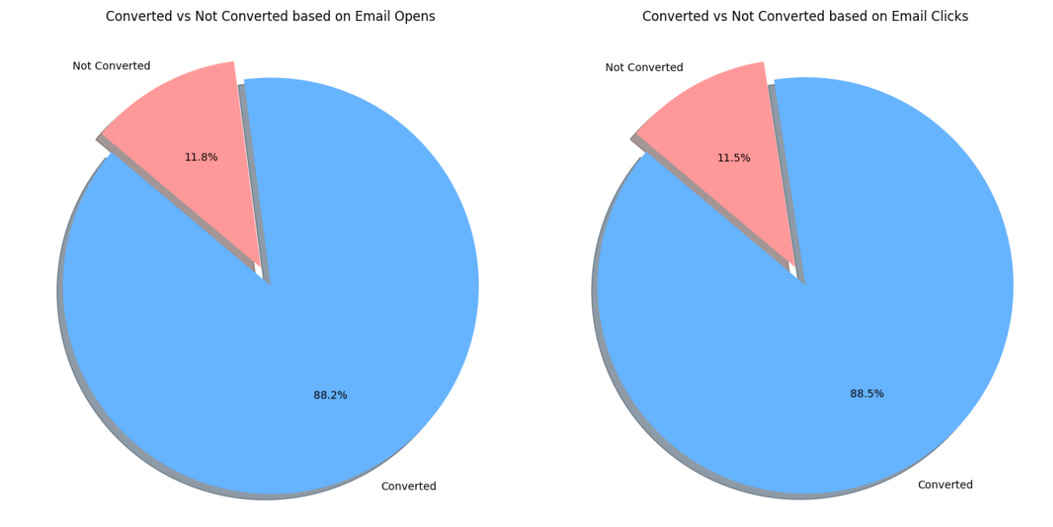
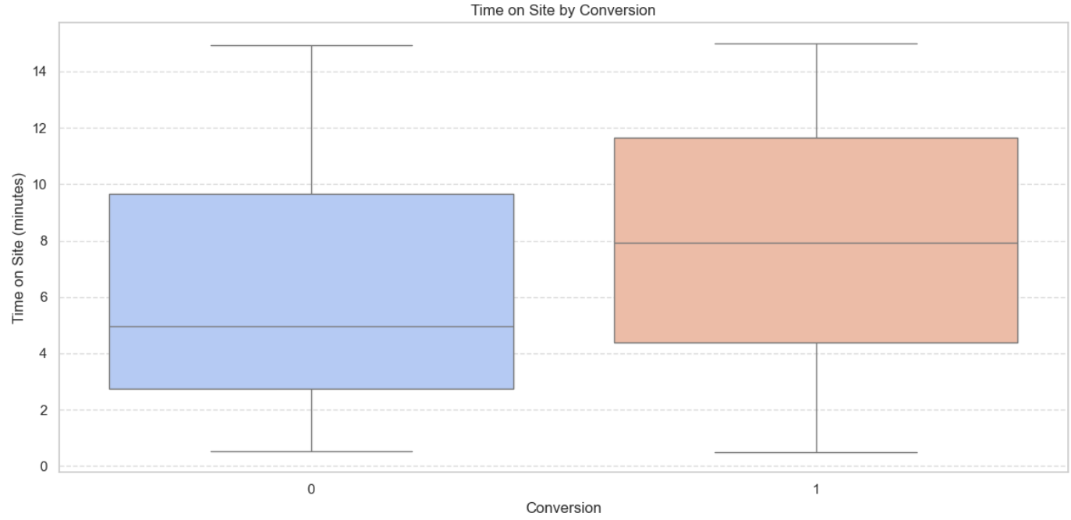
EDA (Exploratory Data Analysis) :

Slide 8

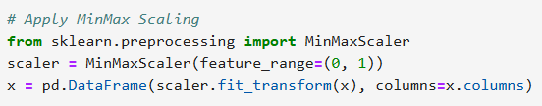
Data Preprocessing :
Categorical Variables to numerical:
One-Hot Encoding Helps converts categorical values into numerical form
MinMaxScaler() scales numerical values between 0 and 1, ensuring all features are on the same scale.
Helps models like Decision Trees, Random Forest, Gradient Boosting and XgBoost perform efficiently
Min Max Scaler:

Slide 9
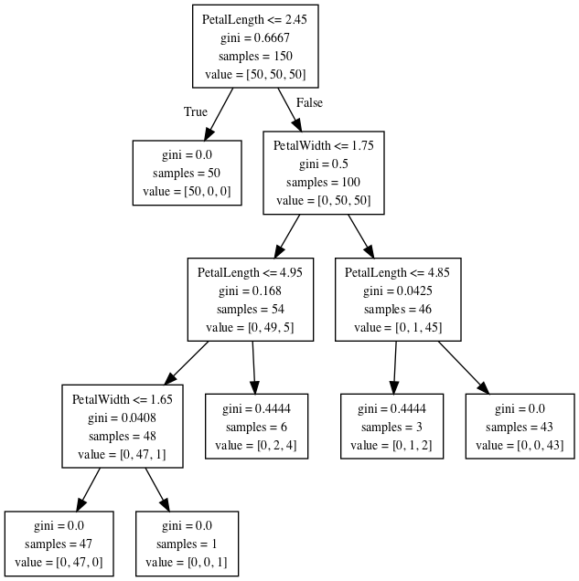
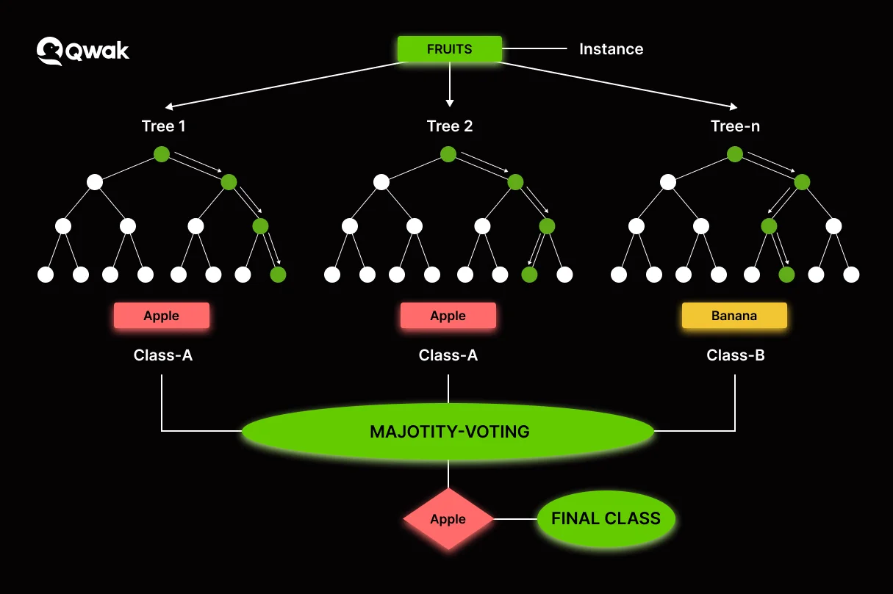
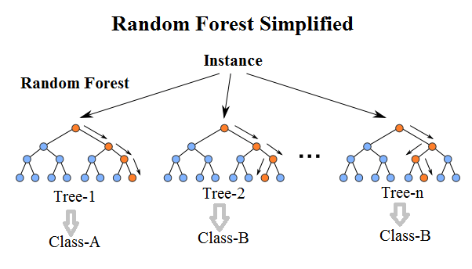
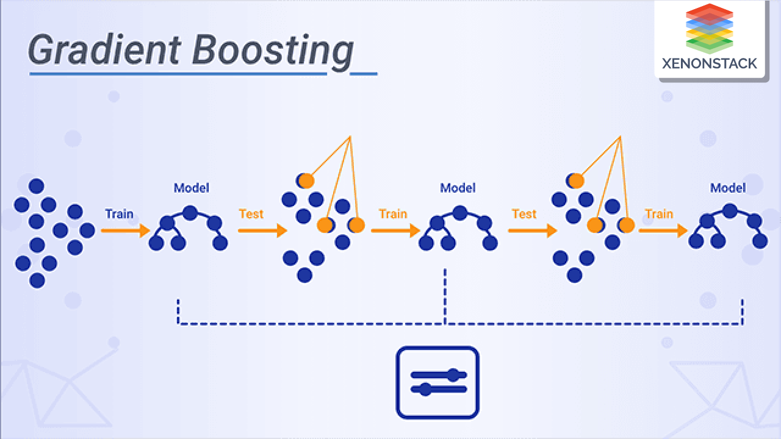
Model Building:
The Machine learning model that have been created are Decision Tree, Random Forest, XgBoost and Gradient Boosting
Decision tree
Xg boost
Random Forest
Gradient Boosting

Slide 10
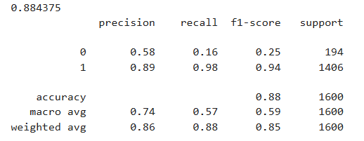
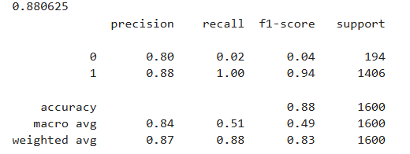
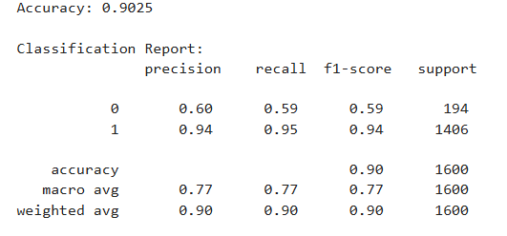
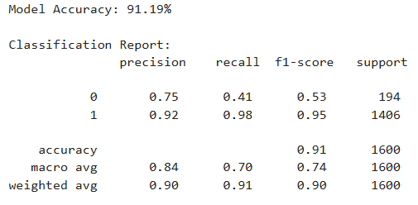
Evaluation Matrix :
Decision Tree
Random Forest
Xg Boost
Gradient Boosting
All the models are struggling a bit to identify/predict The non converted class, although Xg Boost is performing decently since tweaking its parameters of scale_pos_weight helps improve the identification.

Slide 11
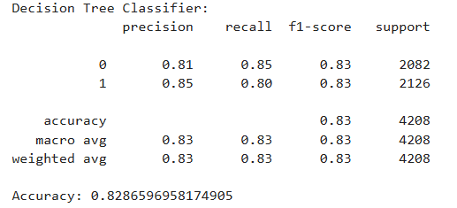
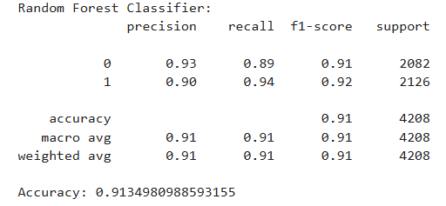
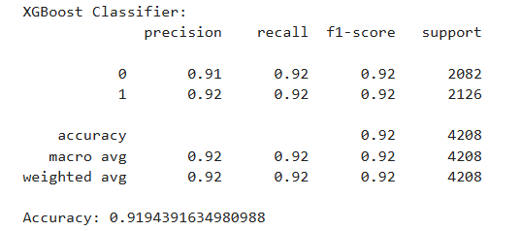
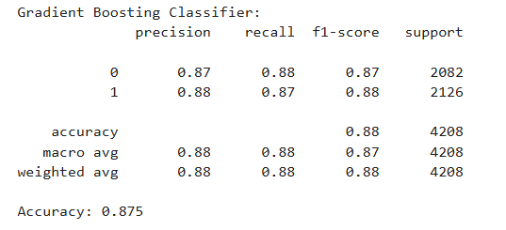
Evaluation Matrix (Over-sampling) :
Decision Tree
Random Forest
XGBoost
Gradient Boosting

Slide 12
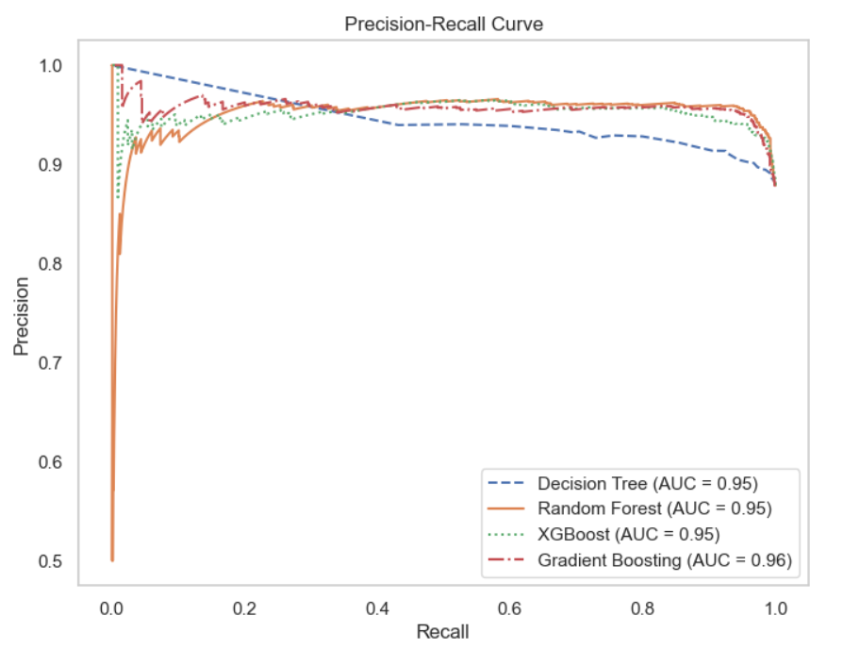
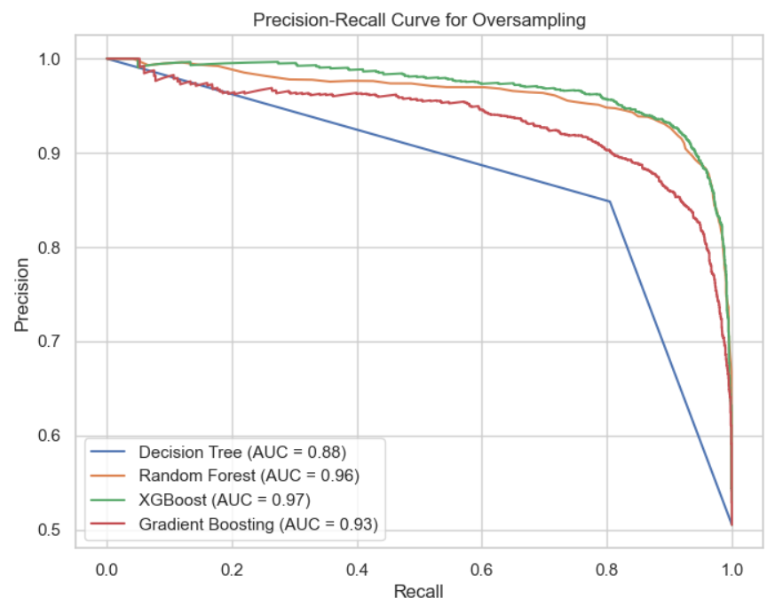
Precision Recall Curve :
Gradient Boosting has the highest Auc (0.96), and the rest of the models have performed equally well
The best performing model is Xgboost

Slide 13
Conclusion :
The XGBoost model outperformed other models with a precision-recall AUC of 0.97, demonstrating its superior capability to accurately identify both converted and non-converted instances in the imbalanced dataset. This makes it the ideal choice for deployment in digital marketing campaigns.
Utilizing the XGBoost model for targeting converted users can significantly enhance the efficiency of digital marketing efforts. By improving the accuracy of identifying potential conversions, businesses can allocate resources more effectively, leading to higher conversion rates and better ROI.
Further optimization and tuning of ensemble methods such as Random Forest and Gradient Boosting, along with advanced techniques like LightGBM and CatBoost, could potentially enhance model performance even further. Continuous monitoring and adaptation will ensure sustained success in handling imbalanced datasets.
Limitations :
While techniques like SMOTE and class weighting were applied to address class imbalance, some models still struggled with correctly identifying minority class instances. Further fine-tuning and exploration of additional resampling methods may be required for optimal performance.

Slide 14
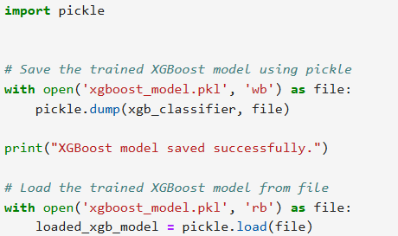
Saving and Loading XgBoost Model

Slide 15

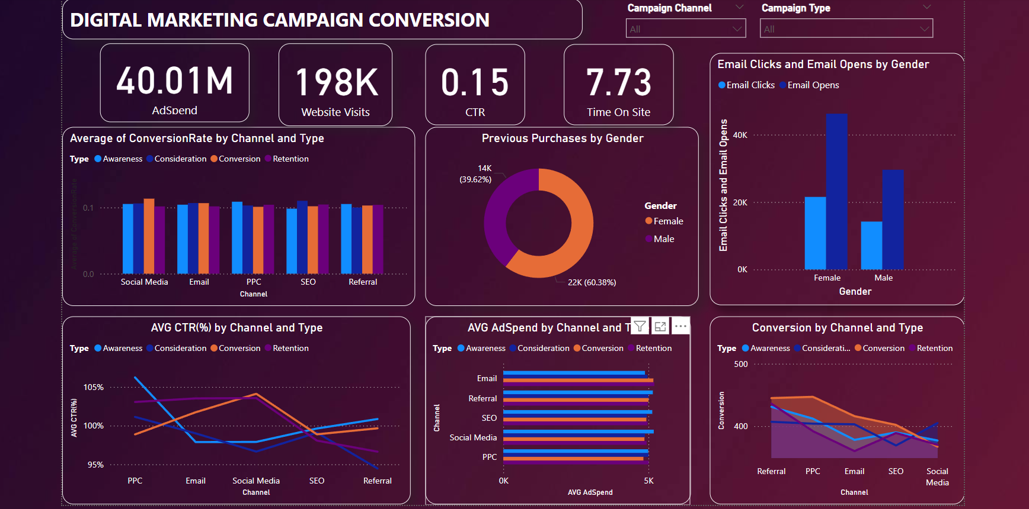
Power BI Dashboard :

Slide 16


